Slide 1

Capital Utilization

Slide 2
Capital Input
Capital utilization rate
  The fraction of the capital stock used in production.
    可以理解为机器设备每天的开机时间，可以24小时不间断，或者，12小时开机+12小时关机休息
    κ (the Greek letter kappa) represents the utilization rate for the capital stock, K.
    Y= A· F(κK, L)

Slide 3
Capital Input
κK, rises with the utilization rate, κ.
  Therefore, an increase in κ raises real GDP, Y, for a given technology level, A, capital stock, K, and labor input, L.

Slide 4
Capital Input
The Demand for Capital Services
  Firms maximize real profit
    π/P= A·F [(κK)^{d}, L^{d})] −(w/P) · L^{d}− (R/P)·(κK)^{d}

Slide 5
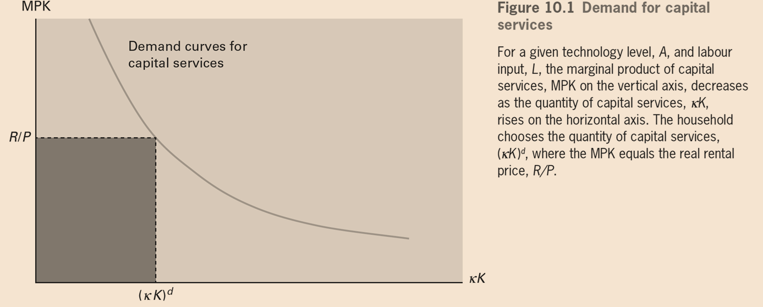
Capital Input

Slide 6
Capital Input
The Demand for Capital Services
  Assume that the technology level rises from A to A’. This change raises the MPK at a given quantity.

Slide 7
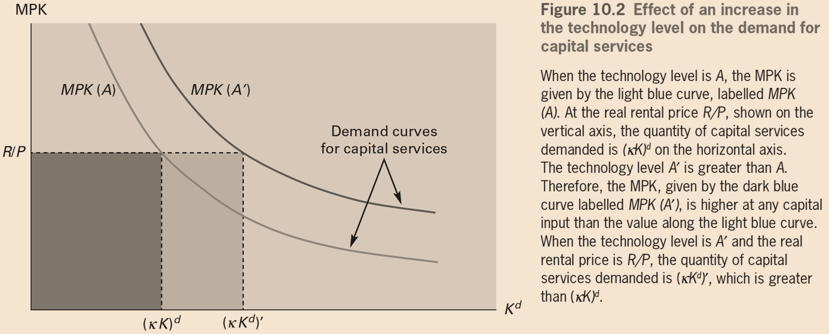
Capital Input

Slide 8
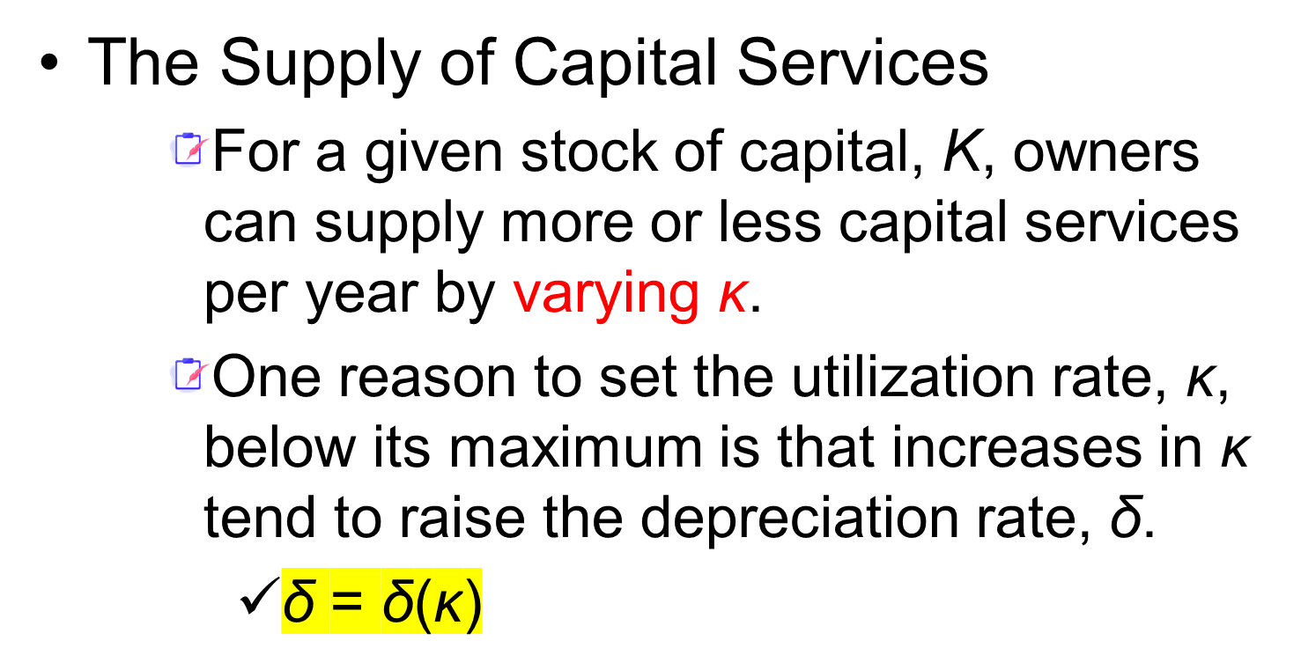
Capital Input

Slide 9
Capital Input
The Supply of Capital Services
  Net real income from supplying capital services
    = real rental payments− depreciation
    = (R/P) · κK − δ(κ) · K
    = K·[(R/P)·κ − δ(κ)]
  Rate of return from owning capital
    = (R/P)·κ − δ(κ)

Slide 10
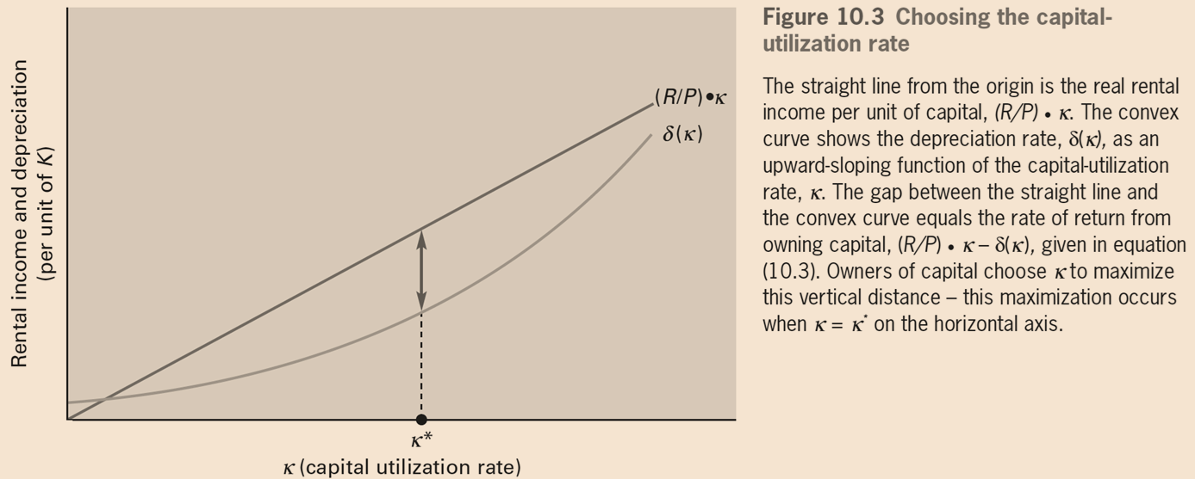
Capital Input
Owners of capital (households) select the utilization rate, κ, that maximizes (R/P)·κ−δ(κ) ，where κ = κ∗

Slide 11
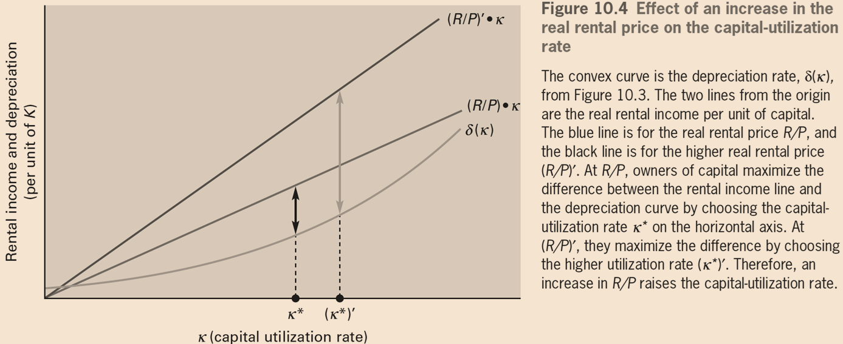
Capital Input
Thus, an increase in the real rental price （R/P） raises the capital utilization rate (κ); the higher real rental price makes it worthwhile to raise κ，despite the resulting increase in the depreciation rate, δ(κ).

Slide 12
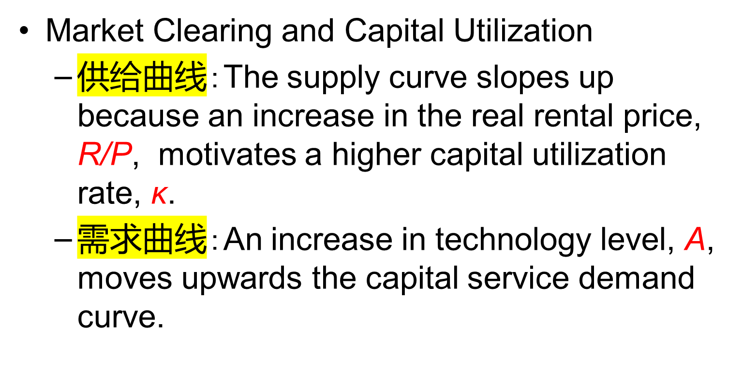
Capital Input

Slide 13
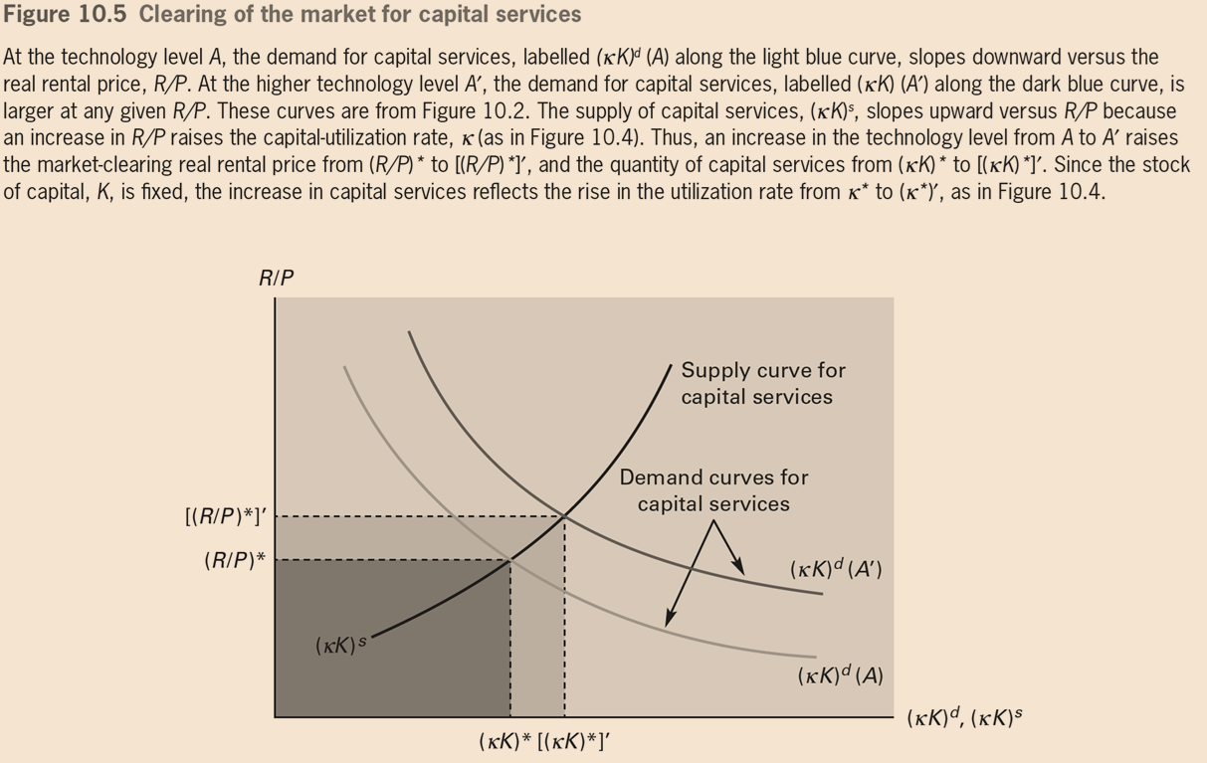
Capital Input

Slide 14
Capital Input
Market Clearing and Capital Utilization
  When the technology level rises to A’, the demand curve for capital services shifts to the right, and the supply curve for capital does not shift.
  Therefore the market clears at the higher real rental price, [(R/P)∗], and the larger quantity of capital services, [(κK)∗].

Slide 15
Capital Input
Till now， we have three reasons why real GDP rises in a boom and falls in a recession.
  A high or low technology level, A, itself causes real GDP to be correspondingly high or low.
  A high or low A causes L to be correspondingly high or low.
  A high or low A causes the quantity of capital services, κK, to be correspondingly high or low.

Slide 16
Capital Input
Market Clearing and Capital Utilization
  i = (R/P) · κ − δ(κ)
  （之前：i = R/P − δ，是因为假定 κ=1）
  Rate of return on bonds
= rate of return on ownership of capital
  Increase in the technology level, A, raises the rate of return from owning capital (since R/P is higher), the interest rate, i, increases. The interest rate is still pro-cyclical in the model.

Slide 17
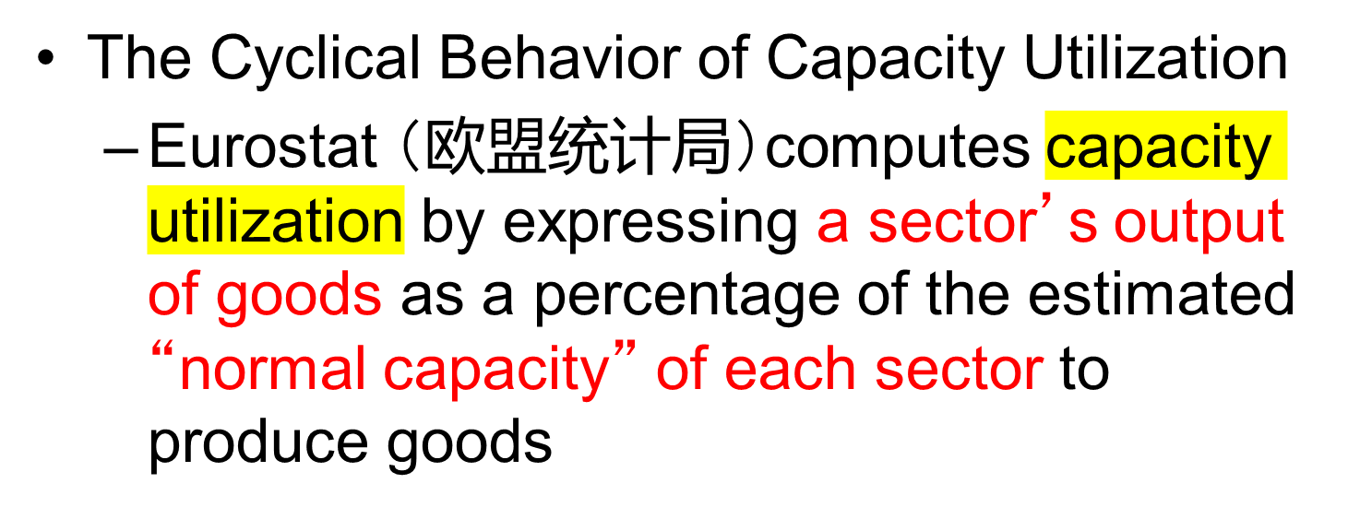
Capital Input

Slide 18
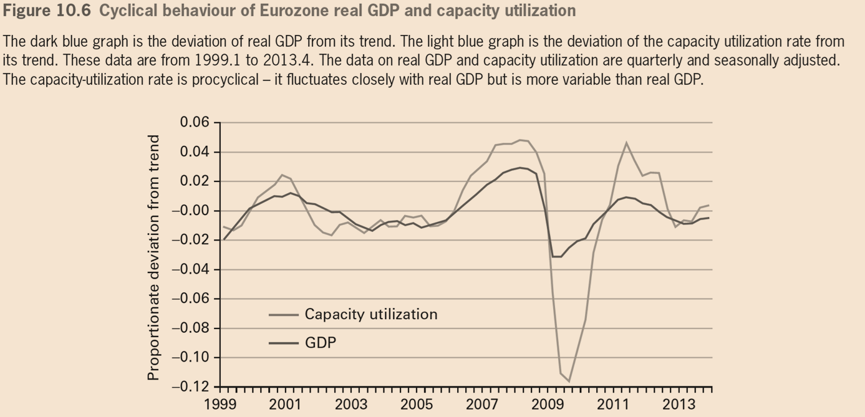
Capital Input

